Slide 1

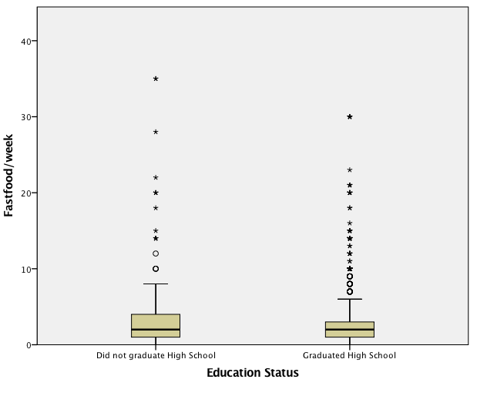
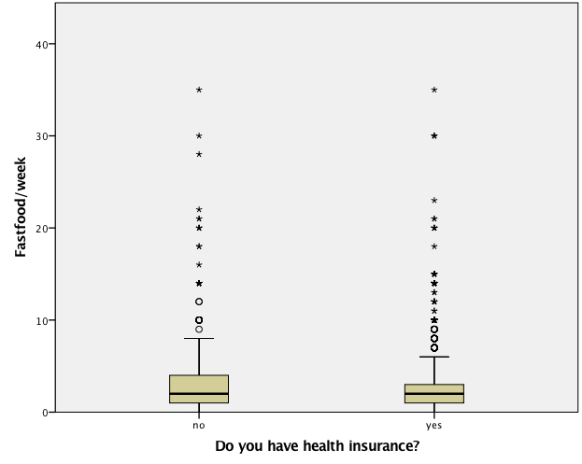
The Relationship between access to healthcare and education and how it affects dietary behavior Leung, Wing Math 615, California State University, Chico, 2017
Introduction
Dietary behaviors are affected by many factors both physically and mentally. Many people make dietary choices are that detrimental to their health and follow fad diets without properly researching what it can do to your body, especially those with certain dietary restrictions due to metabolic disease. Those without healthcare may be unaware of the metabolic disorders they face.
Disparities in health is due to lack of access to high quality food and healthcare.¹ Those who are low income, or live in a food desert, have trouble locating healthy food for themselves and their family. Those who are without healthcare are also without access to asking questions about their health and how to improve it. Generally those who are food insecure are without access to high quality foods and have a higher prevalence of obesity and other metabolic disorders.²
With obesity becoming a more prevalent problem in the US, it is important to explore what could be causing it. Understanding dietary behaviors is important in combatting the metabolic diseases that the US faces. Dietary behaviors can be influenced by many factors, from physical to mental, or simply ignorance of diet.
Research Questions
Is there a relationship between access to healthcare and dietary behaviors?
Is there a relationship between access to education and dietary behaviors?
Are people with access to healthcare more aware of their dietary behaviors?
Hypotheses
Those who have healthcare will have better dietary behaviors.
Those who are educated will have better dietary behaviors.
Methods
Data was obtained from the public use file Add Health that is representative sample of population
Variables that were used and recoded
fast food consumption per week which was dichotomized to fast food consumption yes or no for logistic regression.
Health insurance status which was dichotomized to health insurance yes or not
Education status was dichotomized to graduated high school or did not graduate high school.
BMI which was dichotomized into “underweight / normal” and “overweight / obese” and also split
Dichotomized health insurance was used as a confounder in the multivariate model.
Sample Characteristics
Results: Bivariate Graphics
Conclusion
This study conducted an independent sample t-test and found that the participants who graduated from high school had better dietary habits since those participants consumed significantly less fast food (2.28 times per week + 2.694) compared to those who did not graduate high school (3.26 times per week +4.492), 95% CI .480-1.486, p<0.001. (Figure 1)
The study conducted an independent sample t-test and found that the participants who had health insurance had better dietary habits since the participants consumed statistically significantly less fast food (2.22 times per week + 2.680) compared to those who did not have health insurance (2.77 times per week + 3.384), 95% CI .329-.769, p<.001. (Figure 2)
A logistic regression was performed (Table 2) to ascertain the effects of BMI on the likelihood that participants would consume fast food. The logistic regression model was statistically significant and showed that as one unit of fast food was consumed, the odds ratio of BMI is .336 times higher, 95% CI 1.22-1.603, p<.001. When the binary health insurance confounder was added to the model, as one unit of fast food was consumed, the odds ratio of BMI was reduced to -.255 with 95% CI of .656-.915, p=.003. Since the relationship is still significant, health insurance is not a confounder in the relationship between fast food consumption and BMI.
Figure 1: This figure shows the relationship between education status and fast food consumption per week. The mean for fast food consumption in those who graduated is 2.28 (+2.694). The mean for fast food consumption for those did not graduate is 3.26(+4.492). The p-value is <.001 and the CI is .480-1.486.
Implications
With obesity and metabolic diseases becoming more prevalent in the United States⁴, it is imperative to begin looking for ways to combat this problem. This study shows that access to health care and education resulted in a decrease in consumption of fast food. Reduction in these dietary behaviors may be due to knowledge that the participants receive in school. It may also be due to the participants being aware of their health status when they have health insurance. Future studies may need to expand collecting accurate data for food consumption as there was a lot of perceived outliers seen when analyzing the data.
Figure 2: This figure shows the relationship between health insurance status and fast food consumption per week. The mean for fast food consumption for those with health insurance is 2.22(+2.680). The mean for fast food consumption for those without health insurance is 2.77(+3.384). The p-value is <.001 and the CI is .329-.769.
Results: Multivariate Model
Limitations
Table 1: Sample Characteristics
Participant Demographic n= 6504
 |  |  |  | n | %
Gender
 | Male |  |  | 3147 | 48.4
 | Female |  |  | 3356 | 51.6
BMI
 | <18.5 |  |  | 77 | 1.2
 | 18.5-24.9 |  |  | 1578 | 24.3
 | 25-29.9 |  |  | 1498 | 23
 | >30 |  |  | 1961 | 30.2
Age ( 29+1.775)
 | 25 |  |  | 7 | 0.1
 | 26 |  |  | 464 | 7.1
 | 27 |  |  | 724 | 11.1
 | 28 |  |  | 884 | 13.6
 | 29 |  |  | 914 | 14.1
 | 30 |  |  | 887 | 13.6
 | 31 |  |  | 875 | 13.5
 | 32 |  |  | 307 | 4.7
 | 33 |  |  | 45 | 0.7
 | 34 |  |  | 7 | 0.1
Education - High School Graduate
 | Yes |  |  | 4787 | 73.6
 | No |  |  | 326 | 5
Health Insurance
 | Yes |  |  | 4025 | 61.9
 | No |  |  | 1084 | 16.7
All of the data is self reported.
Table 2: Relationship between Fast Food Consumption and BMI
 | B* | SE** | P-Value | CI***
BMI | 0.336 | 0.069 | <0.001 | 1.22-1.603
Health Insurance | -0.255 | 0.085 | 0.003 | 0.656-0.915
* Regression Coefficient
** Standard Error
*** Confidence Interval
References
1. Ebbeling, Cara., et al. (2012). A randomized trial of sugar-sweetened beverages and adolescent body weight. The New England Journal of medicine. 367:1407-16.
2. Hernandez, Daphne C., Layton M. Reesor, and Rosenda Murillo. “Food Insecurity and Adult Overweight/Obesity: Gender and Race/Ethnic Disparities.” Appetite 117, no. Supplement C (October 1, 2017): 373–78.
3. Walsemann, Katrina M., Annie Ro, and Gilbert C. Gee. “Trends in Food Insecurity among California Residents from 2001 to 2011: Inequities at the Intersection of Immigration Status and Ethnicity.” Preventive Medicine 105 (December 2017): 142–48.
4. “Overweight & Obesity.” Centers for Disease Control and Prevention, Centers for Disease Control and Prevention, 29 Aug. 2017.
Table 2: A binary logistic regression was conducted between fast food consumption and BMI with health insurance status as the binary confounder. The regression coefficient for the relationship between fast food consumption and BMI is .336 with 95% CI of 1.22-1.603, p-value of <.001. When the binary health insurance confounder was added to the test, the regression coefficient was -.255, 95% CI .656-.915, p=.003.
Wing Leung
wleung4@mail.csuchico.edu

